Slide 1
GreenMate
Christopher Huynh
Chen-Yu Chang
Yiqin Zhang
Hanming Wang
Michael Harkess
Samarah Uriarte

Slide 2
Team – Green Dolphin
Christopher Huynh --- Project Lead
Chen-Yu Chang --- Specification Lead
Yiqin Zhang --- Interface Lead
Hanming Wang --- Technical Lead
Michael Harkess --- Technical Lead
Samarah Uriarte --- Documentation Lead

Slide 3
App Purpose
To encourage people to be more eco-friendly, we created an application that records the walking steps, the distance traveled by bicycle, and the recycling history. These actions will reward the users by allowing them to gain some points, and these points then change the bear character’s state. If we are able to work further with other companies, they would also be exchanged for rewards, such as coupons or products.

Slide 4
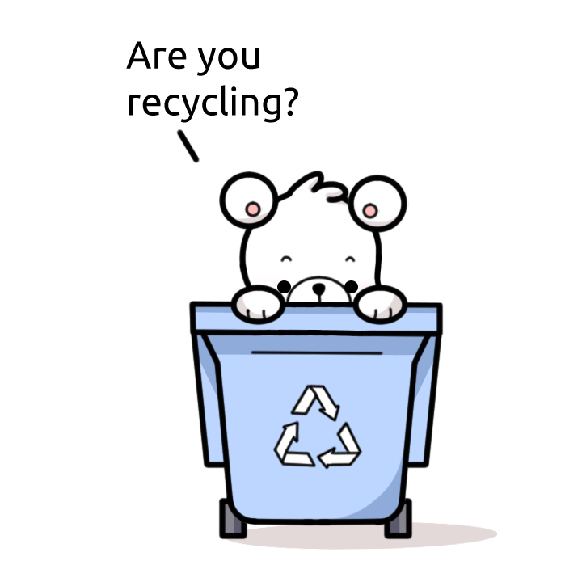


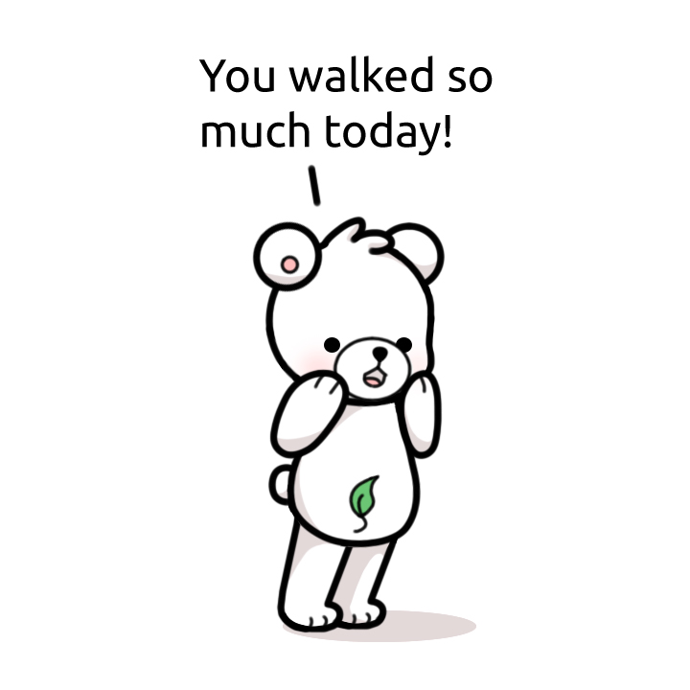
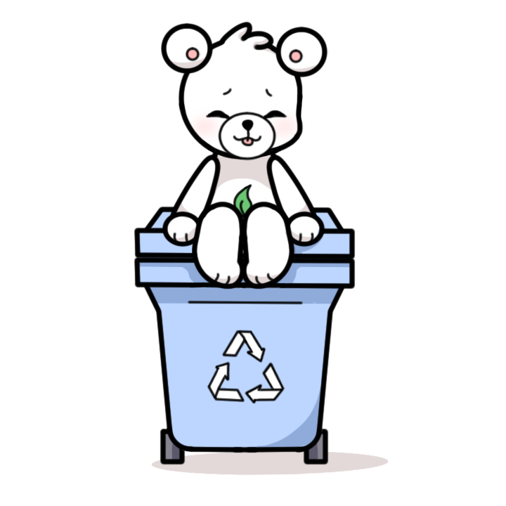


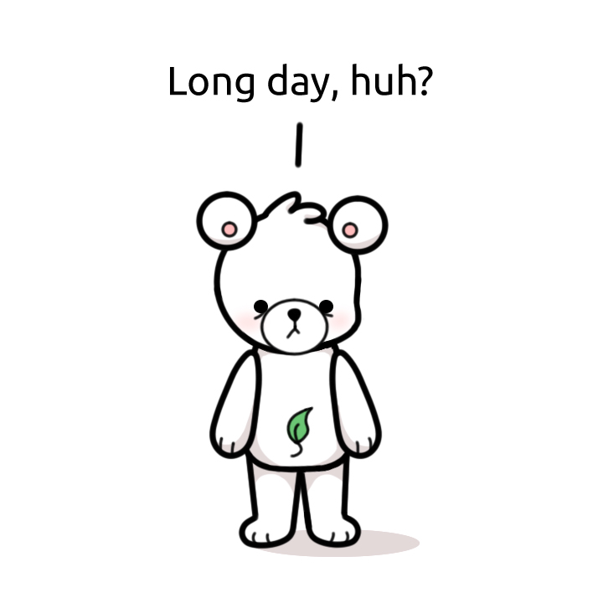

Main Character-Bear
This character, drawn by Samarah, will change into different stages when sensing the user’s situation.

Slide 5
Software Architecture
Home Activity
Sensor Filter
Step Listener
Step Detector
Step Calculation
Login Activity
GPS
Maps Activity
Point System
Recycle Database
Recycle Rules
UI Design

Slide 6
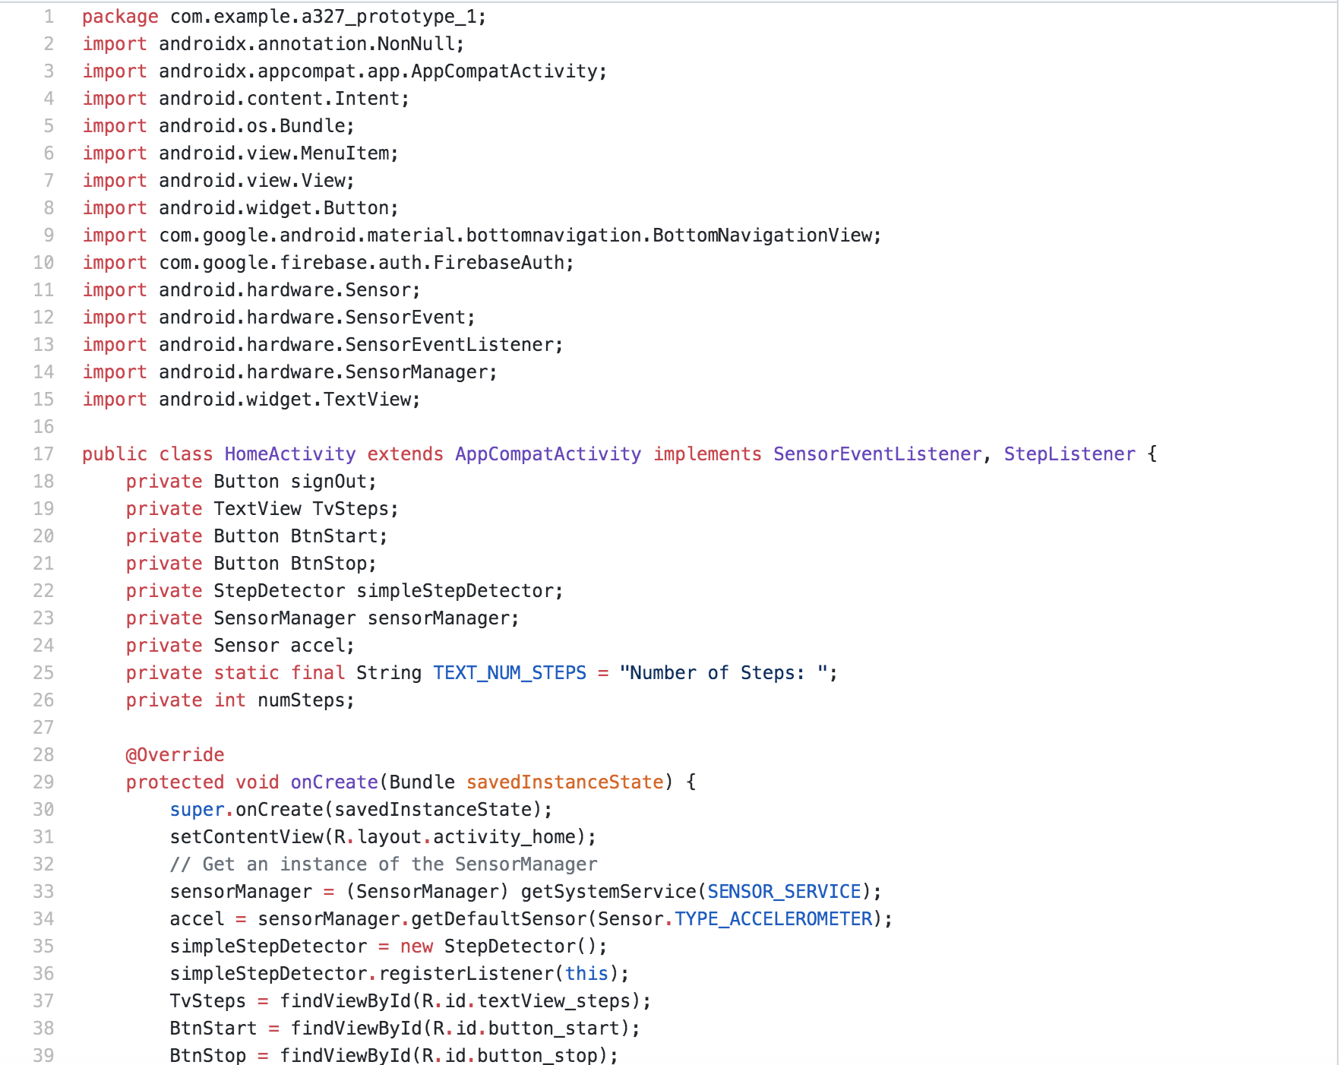
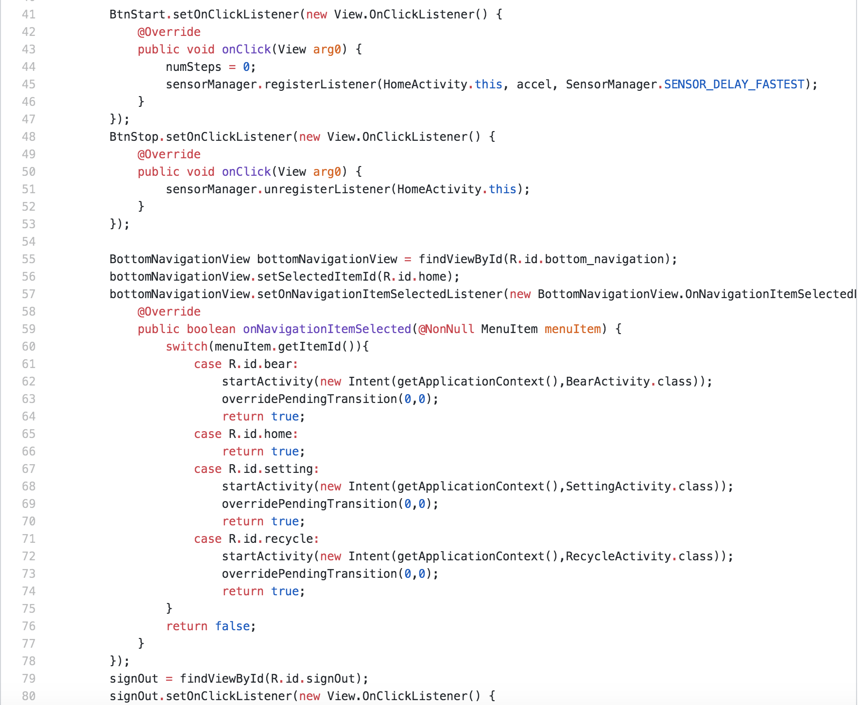
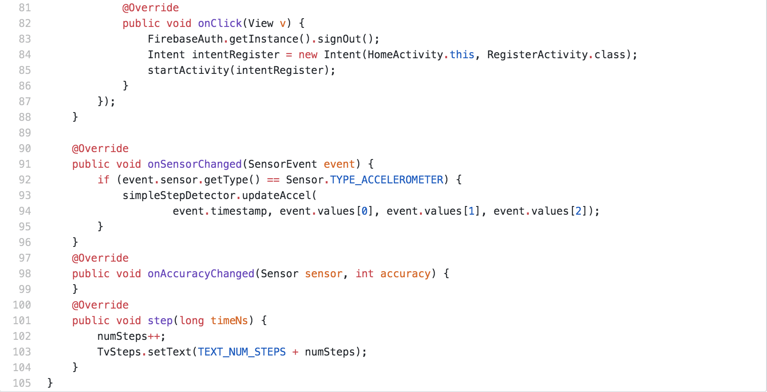
Home Activity
This function combines several other functions for the accelerometer sensor the app uses inside the phone. It is the core of the step counter and has branches, such as Step Detector, Step Listener, Sensor Filter, and Step Calculation. It will record the readings and show the results to the user.

Slide 7
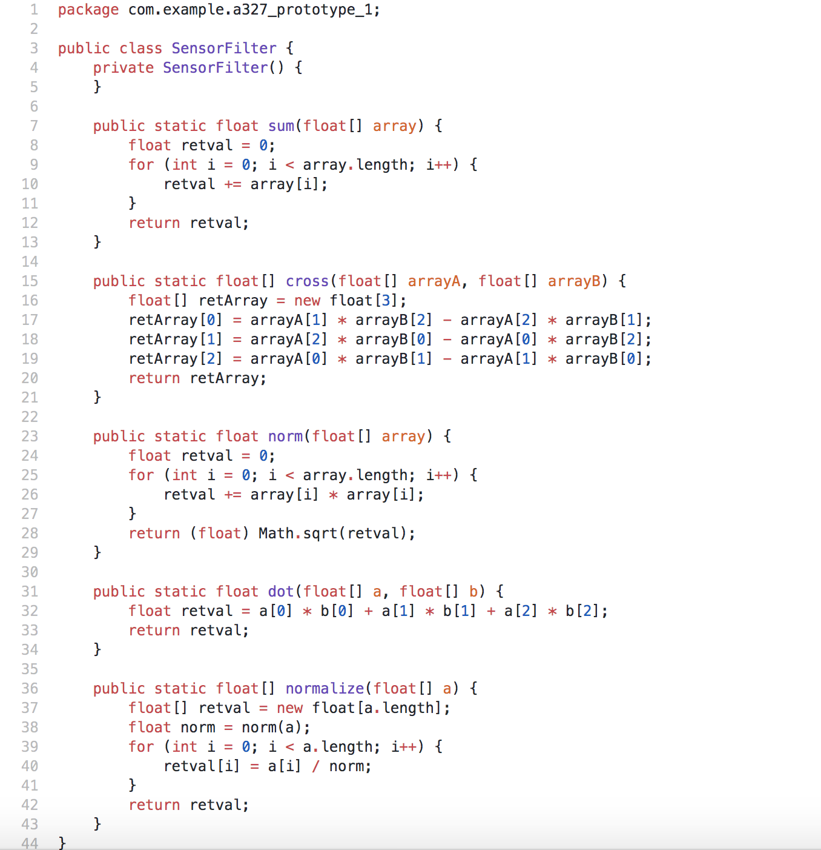
Sensor Filter
This is a class that operates an algorithm to filter out the values that has an approximation of steps by the sensor installed in the phone. This is also a subsystem used in the Home Activity module.

Slide 8
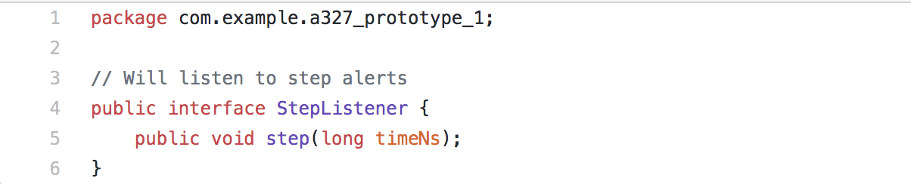
Step Listener
This interface will listen to alerts about steps being detected. This is a subsystem used in the Home Activity module.

Slide 9
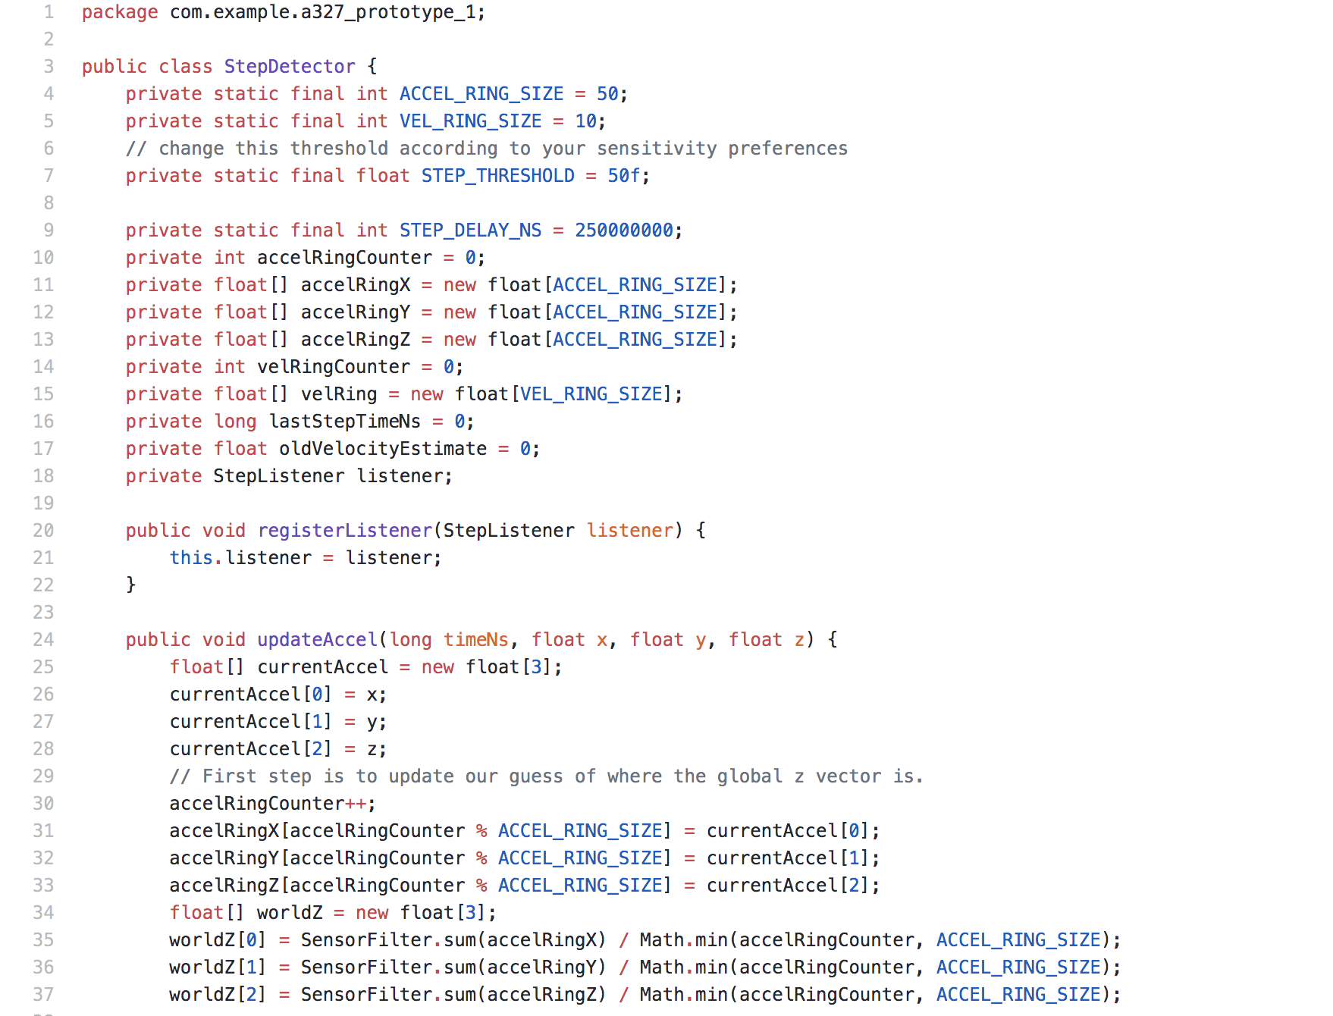
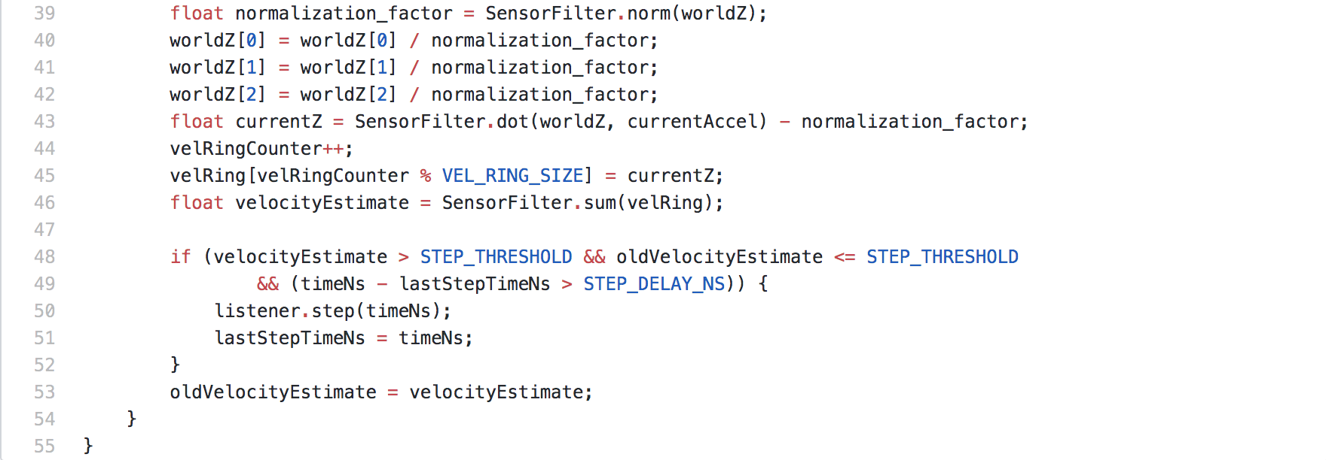
Step Detector
This function creates a class that accepts the updated data from accelerometer sensor and deploys the filter to detect if a step was covered by the user. It is operated inside the Home Activity module after the user presses “start” to start detecting.

Slide 10
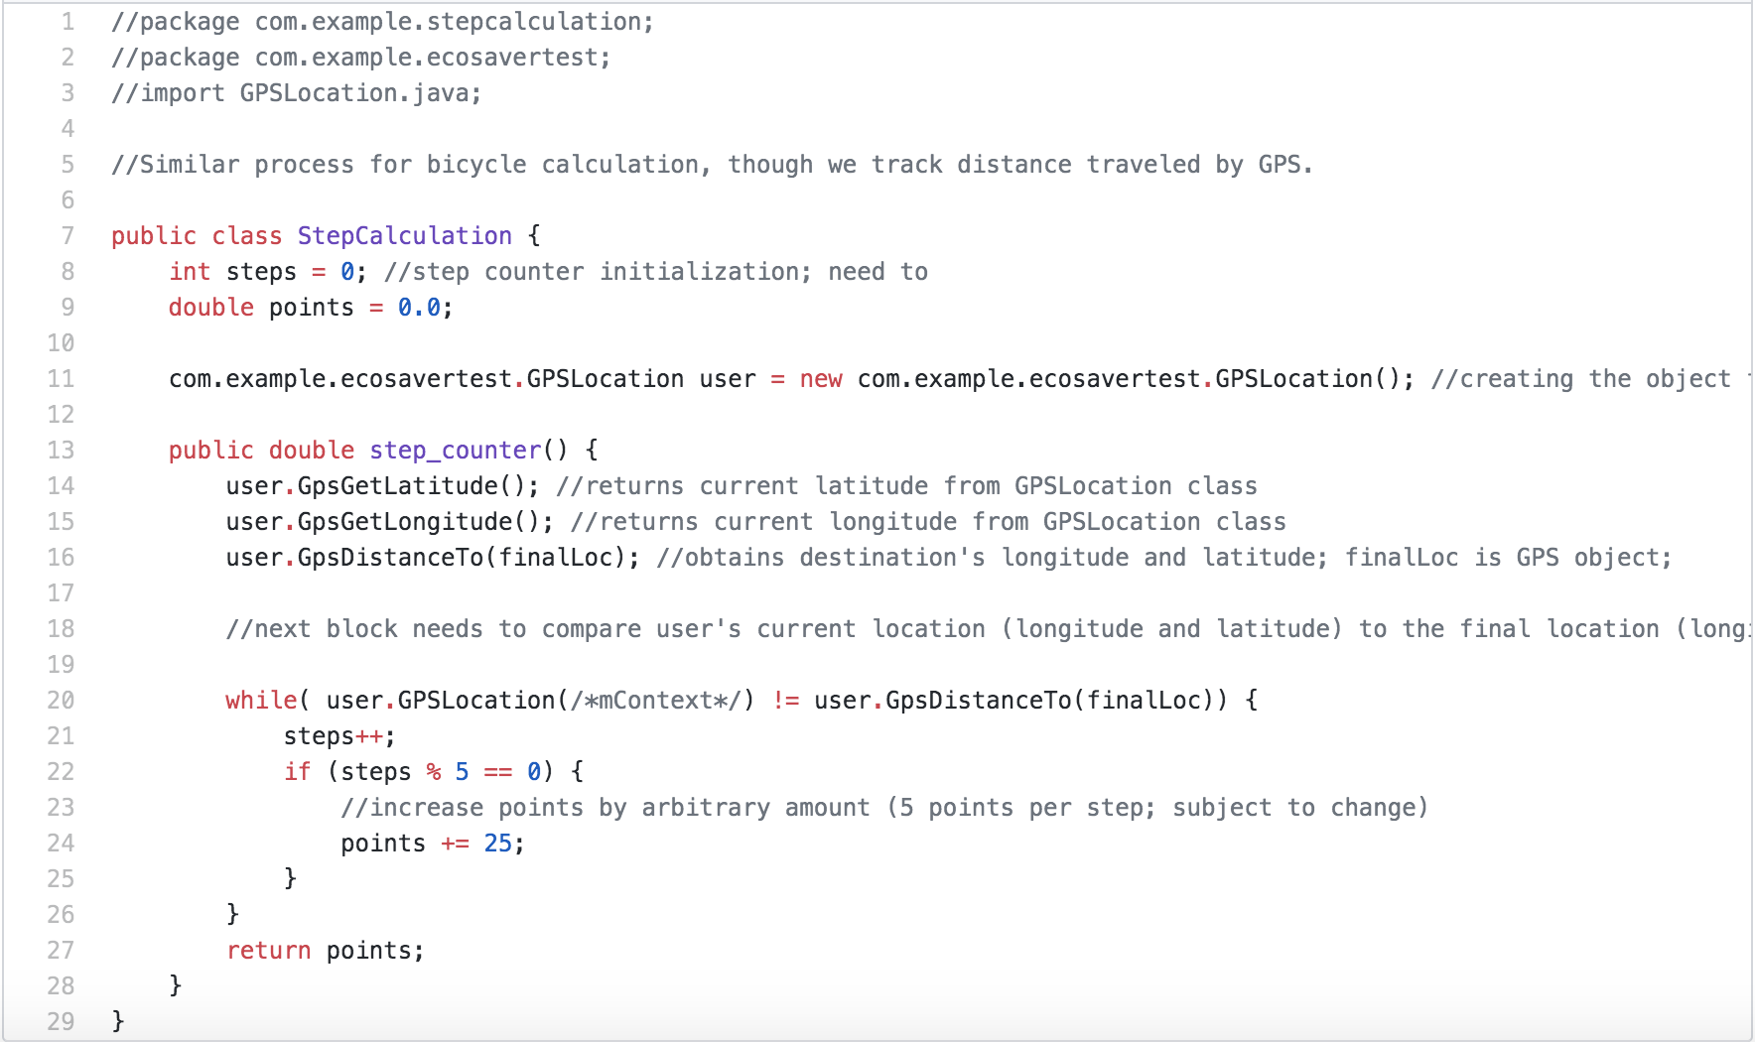
Step Calculation
This function converts the steps recorded into points since the app rewards the user through a point system. Therefore, we designed a system to calculate the conversion between steps and points.

Slide 11
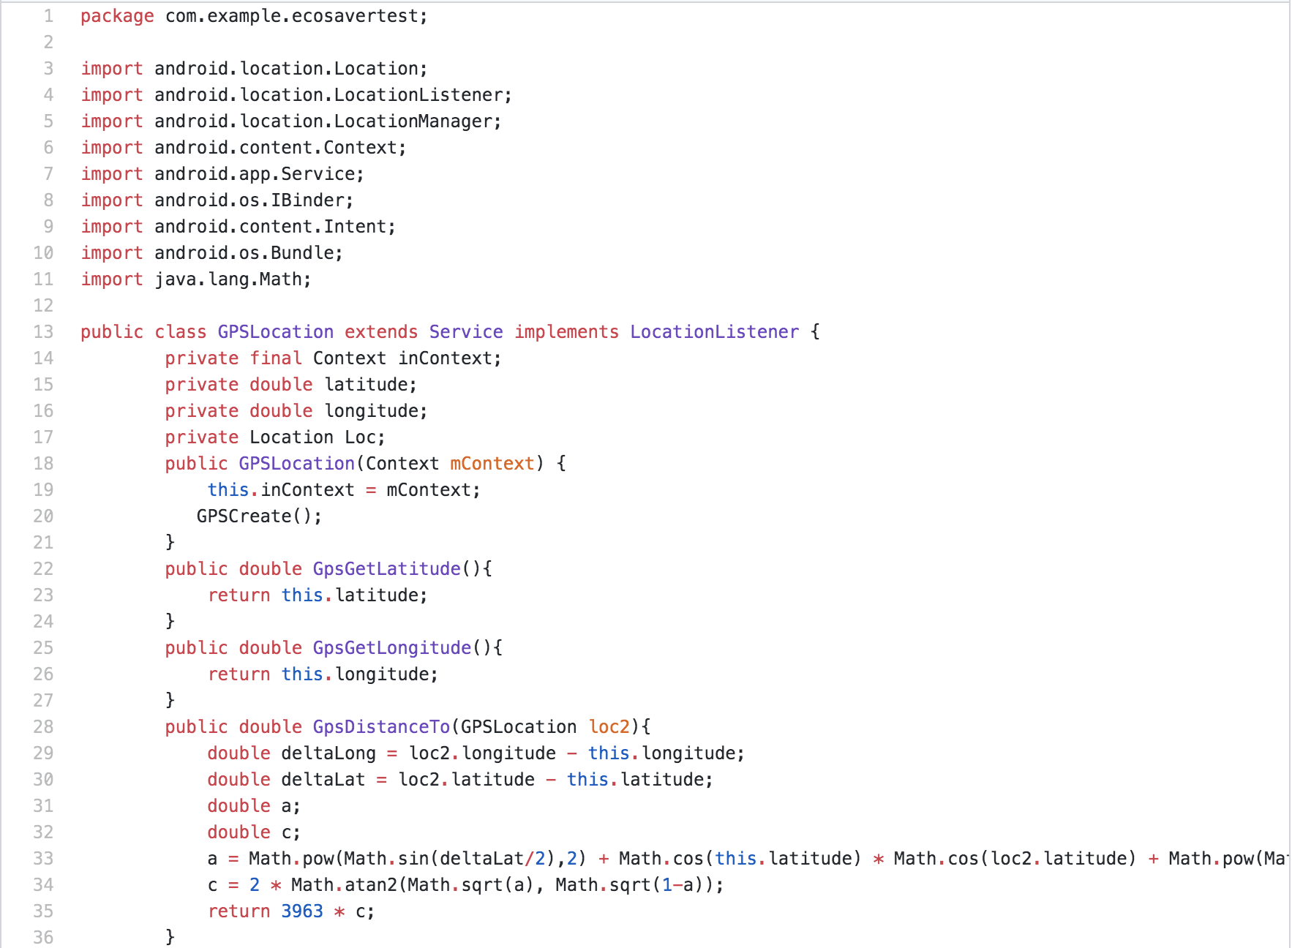
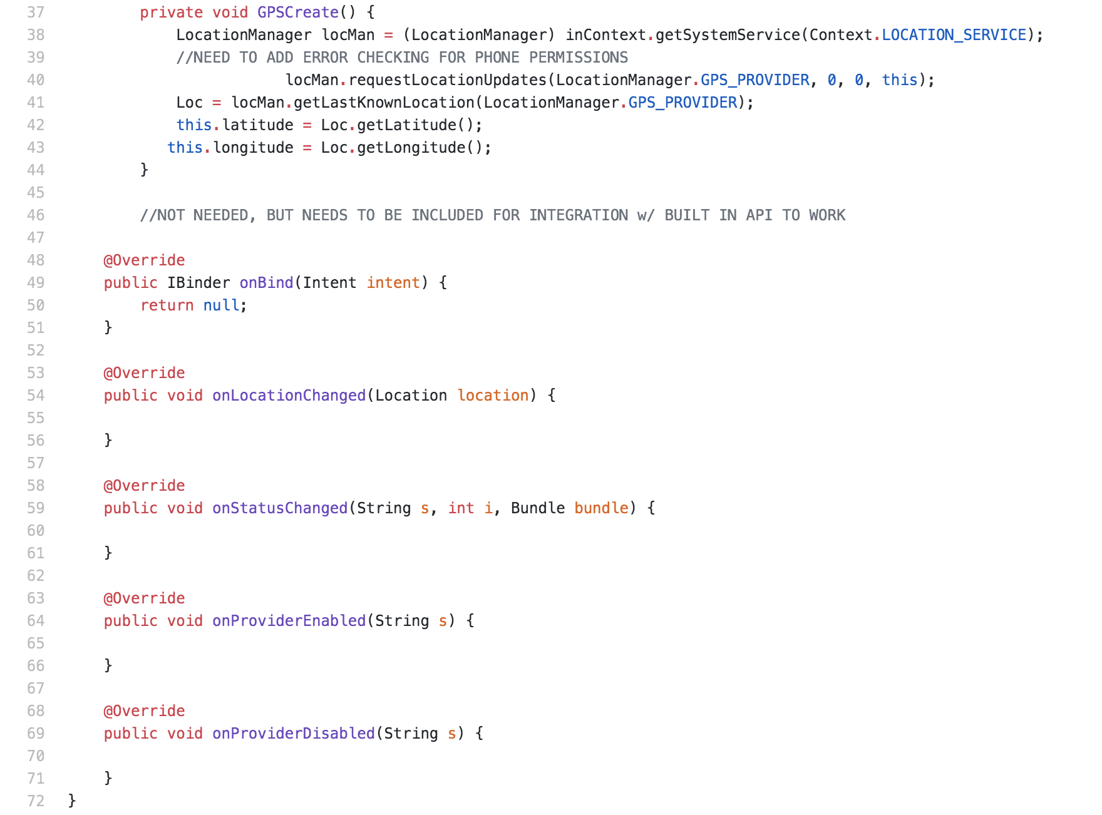
GPS
This function uses two key coordinates, latitude and longitude, to know the user’s exact position. The implementation of distance tracker applications and location tracker apps are features of the GPS function.

Slide 12
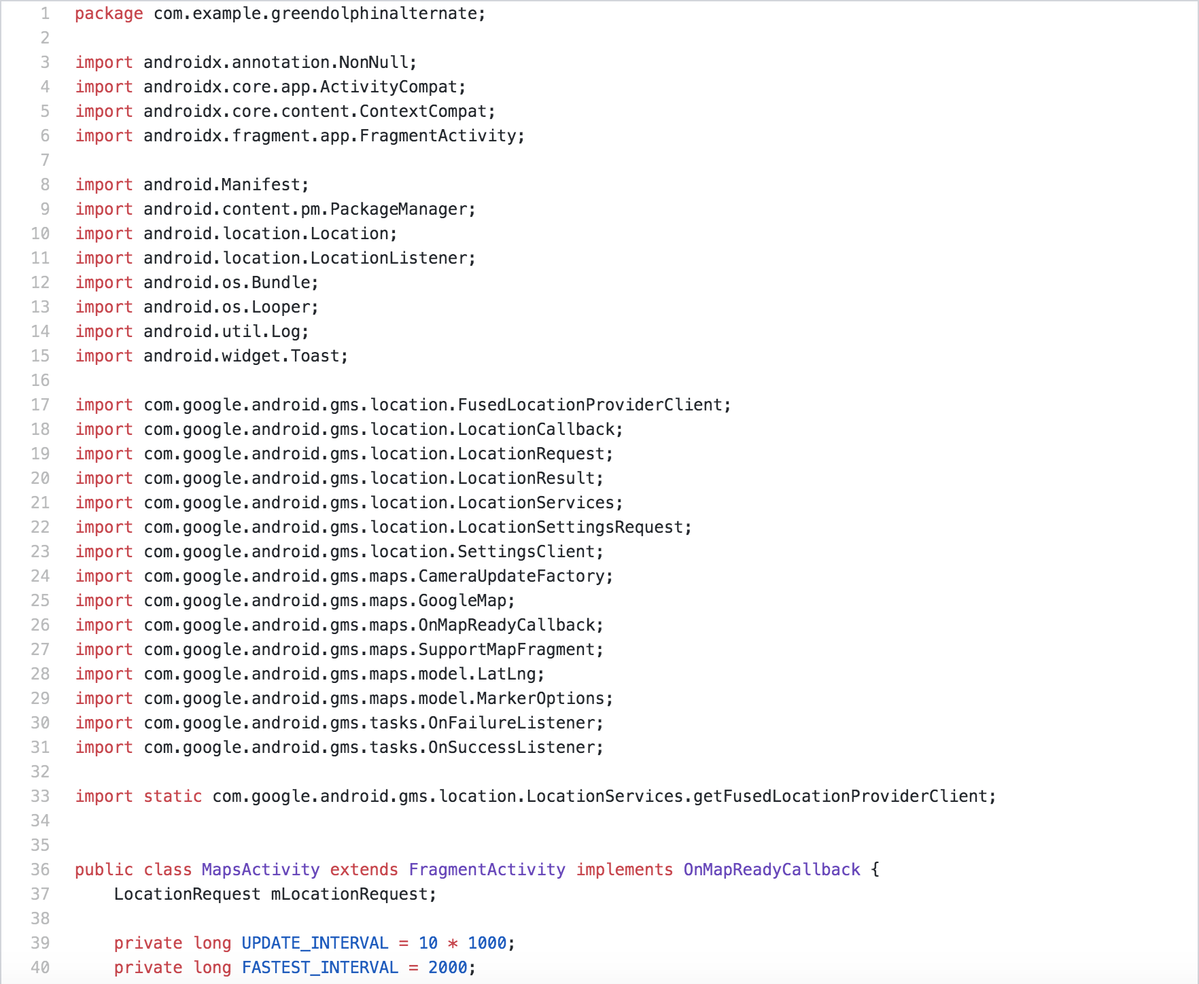
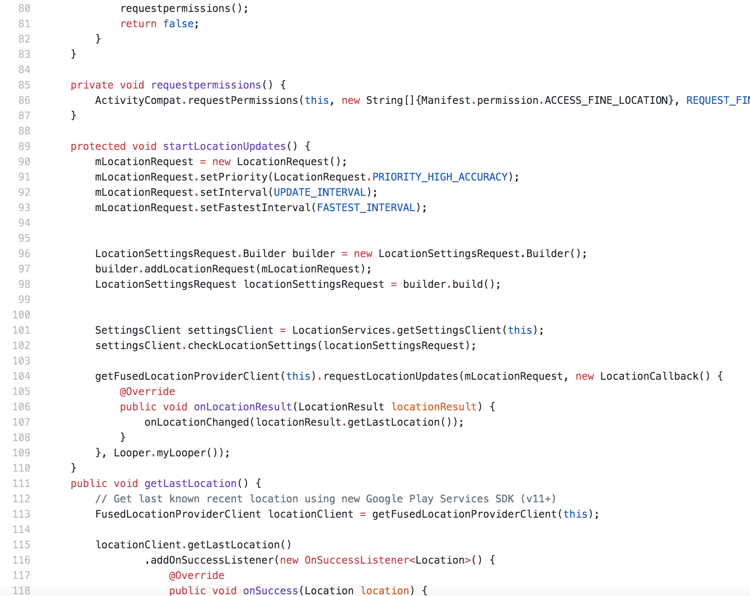
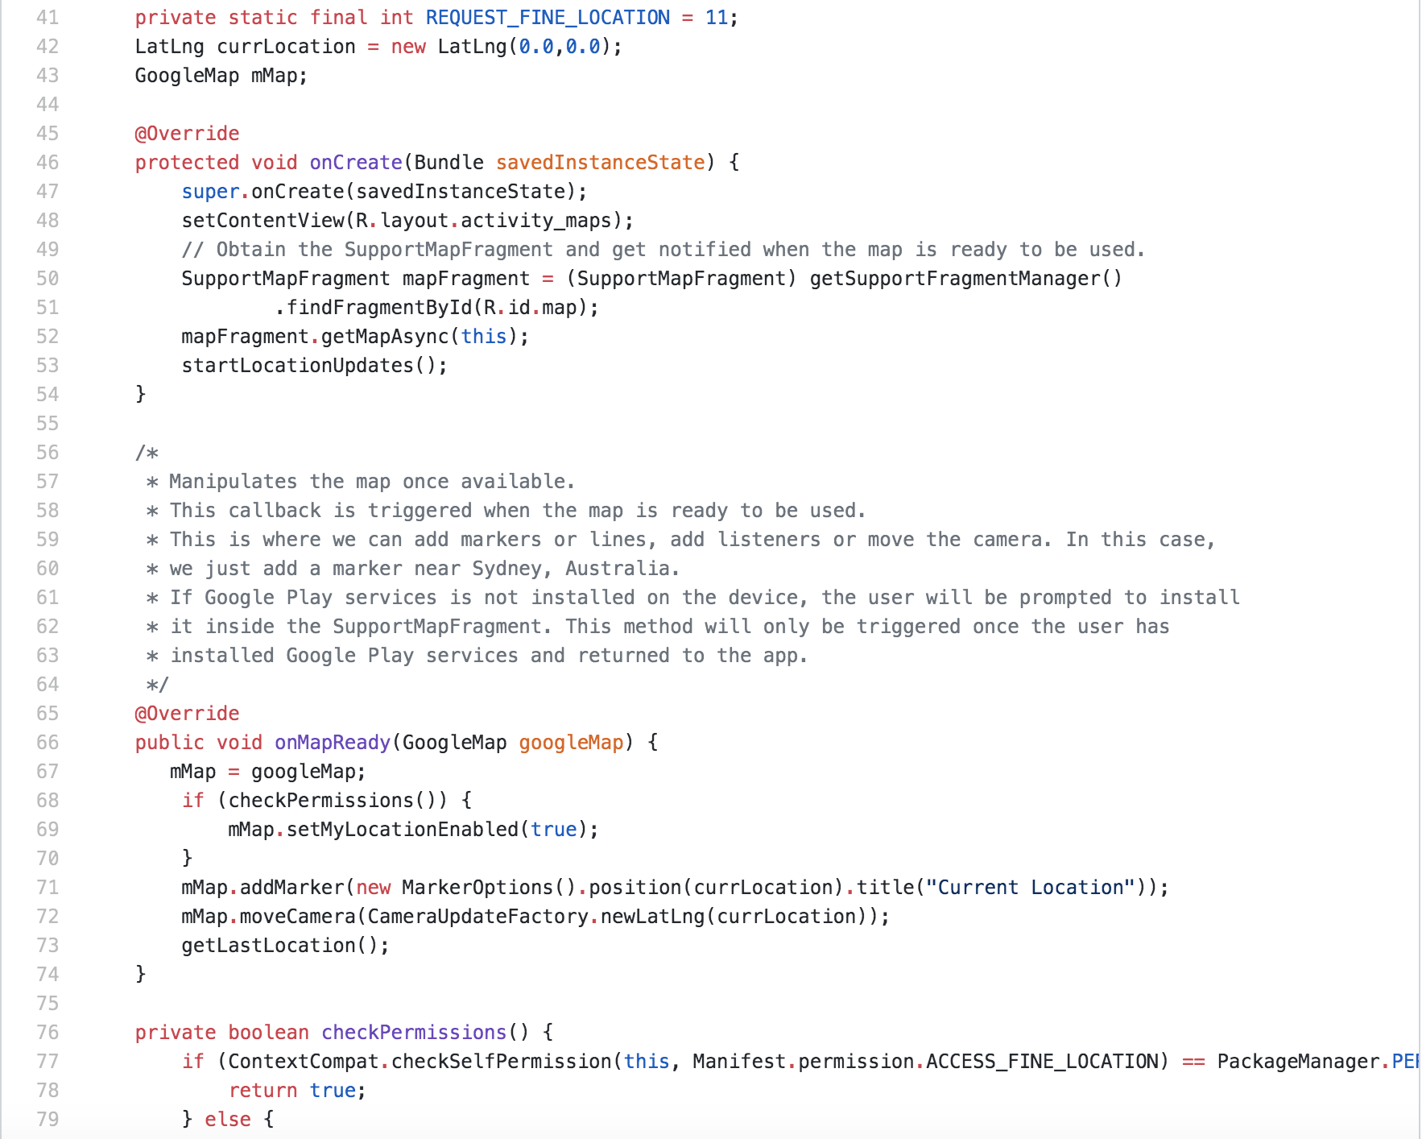
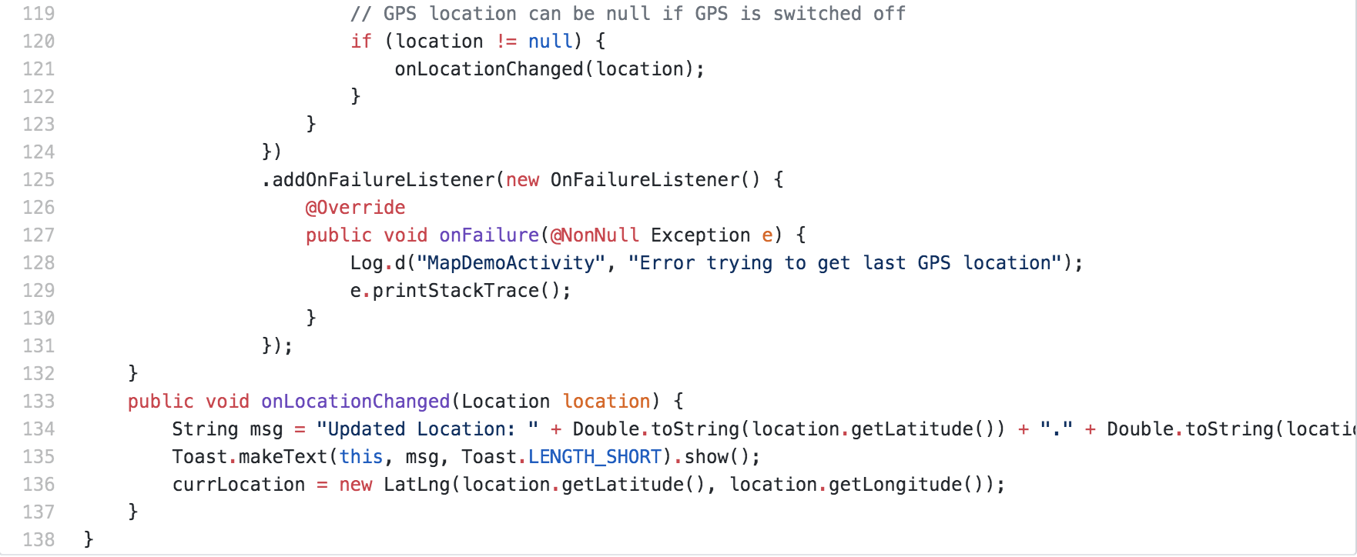
Maps Activity
This function manipulates the map once, allowing us to add markers, lines, and listeners. It provides us the tool of tracking the routine of the user’s walk or bike ride.

Slide 13
Point System
This function filters the amount of recycling and walking or biking. With different amount of work, the bear icon in the main page will change states. This requires distinguishing the different situations the user input, and make interaction between bear and user.

Slide 14
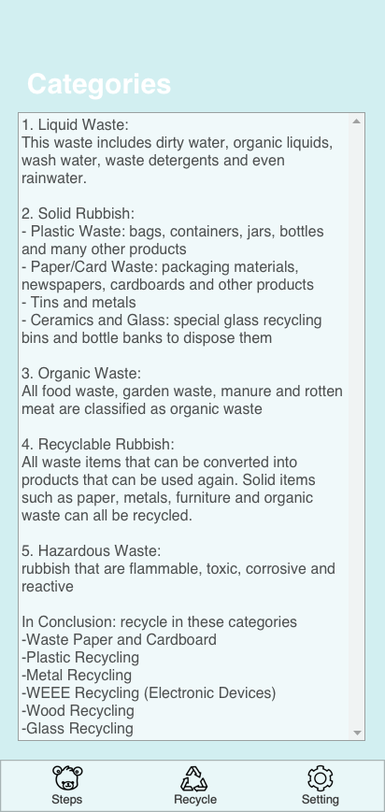
Recycle Database
The database includes the records of the user’s recycling, and the instructions are provided about the categories and whether it can be recycled or not. It is connected with the point system to cooperate with the input the user gave.

Slide 15
Recycle Rules
This function calculates the items that the user recycled by asking for inputs, and converting those items to points.

Slide 16
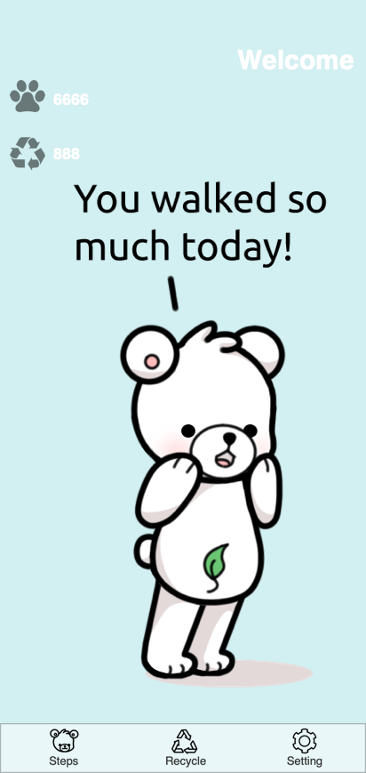
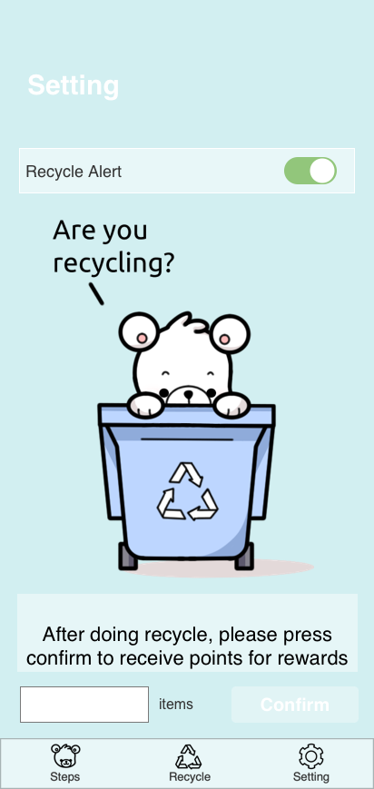
UI Design
The app’s UI design is the interface that the user will directly see. All the buttons, scrolls, and flips are designed from Android Studio. Furthermore, the changing of different images based on different situations is also implemented.

Slide 17
Reference Sites
https://www.tukuppt.com/soback/huanbao.html
http://www.51pptmoban.com/pic/695.html
http://www.51pptmoban.com/pic/450.html
https://www.ntaskmanager.com/blog/5-insane-project-management-techniques-in-todays-market/
https://bauschrewards.com/spendactivities
https://www.123rf.com/photo_81035061_stock-vector-fitness-tracking-app-on-mobile-phone-screen-vector-illustration-flat-cartoon-style-smartphone-with-r.html
https://www.123rf.com/photo_35483452_creative-abstract-gps-satellite-navigation-travel-tourism-and-location-route-planning-business-conce.html
https://www.iconfinder.com/icons/2526356/accelerometer_auto_rotate_mobile_rotate_rotation_screen_smartphone_icon
https://www.elegantthemes.com/blog/wordpress/calculated-fields-form-plugin-overview-and-review
https://us.clipdealer.com/vector/media/A:106834752
https://iconscout.com/icon/gps-1524935
https://www.iconfinder.com/icons/2262525/arrows_bin_eco_ecology_recyclable_recycling_icon
https://www.iconfinder.com/icons/2352275/design_interface_mobile_ui_ux_icon
http://www.51yuansu.com/bg/cqqemkelcd.html
https://www.onlinewebfonts.com/icon/500190

Slide 18
Thank You

